Slide 1
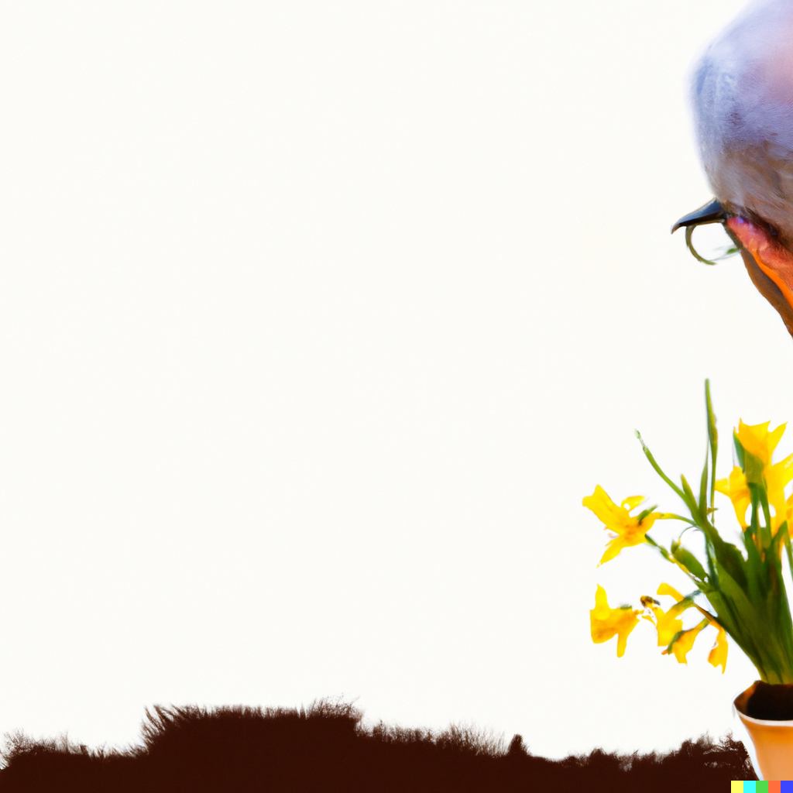










Funded by the European Union. Views and opinions expressed are however those of the author(s) only and do not necessarily reflect those of the European Union or the European Education and Culture Executive Agency (EACEA). Neither the European Union nor EACEA can be held responsible for them. 2022-1-ES01-KA220-ADU-000085390

Slide 2

UNIT 4
Communication & Green Advocacy
Funded by the European Union. Views and opinions expressed are however those of the author(s) only and do not necessarily reflect those of the European Union or the European Education and Culture Executive Agency (EACEA). Neither the European Union nor EACEA can be held responsible for them.

Slide 3
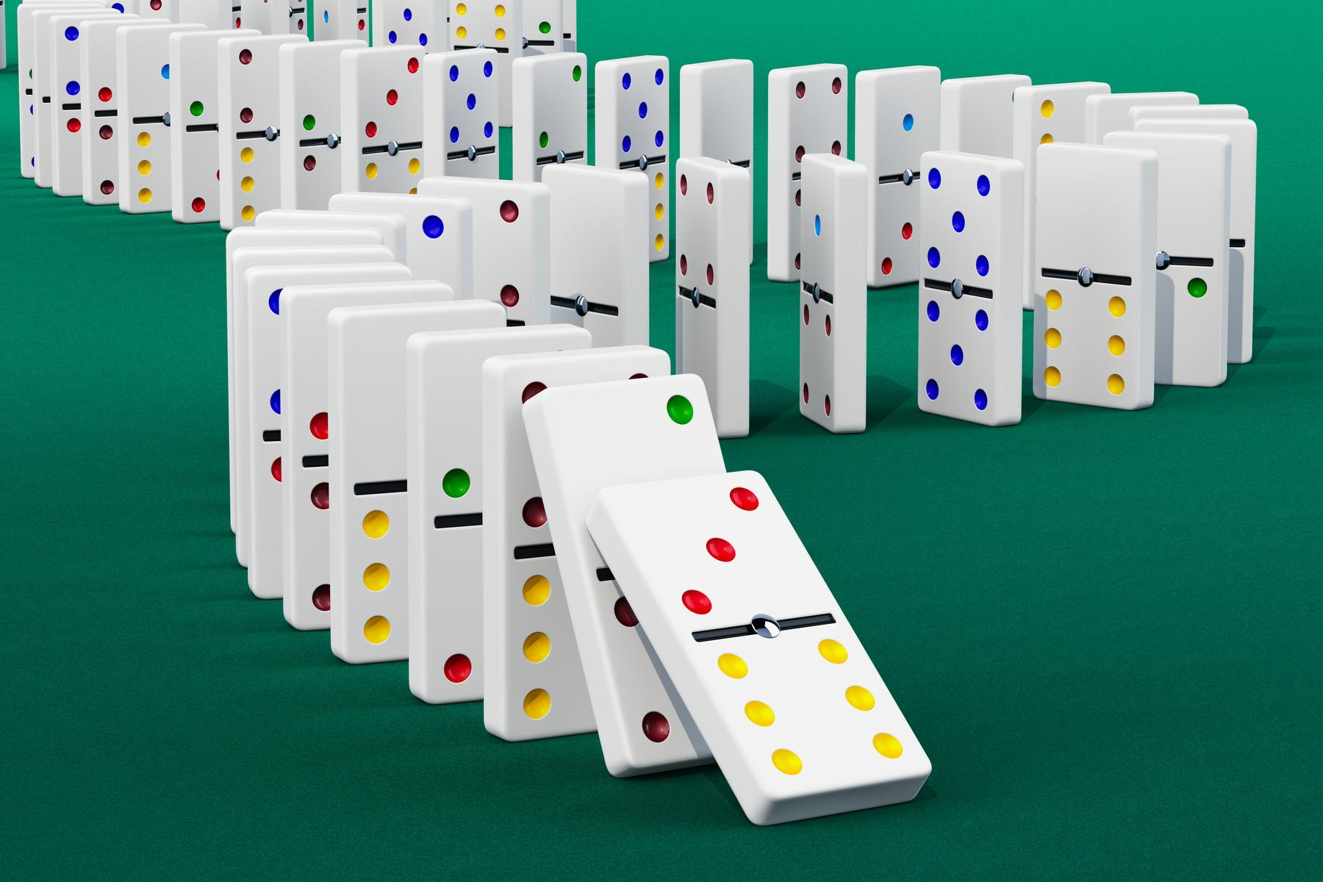
Presentation
Highlights
Effective Communication
Environmental Activism
Collaboration

Slide 4
What will we learn?
  Understanding green advocacy and environmental sustainability.
  Critically analysing communication and consumer goods.
  Environmental awareness and advocacy skills.

Slide 5

ACTIVITY
TIME
Green Communication Icebreaker

Slide 6



Effective Communication for Green Practices

Slide 7
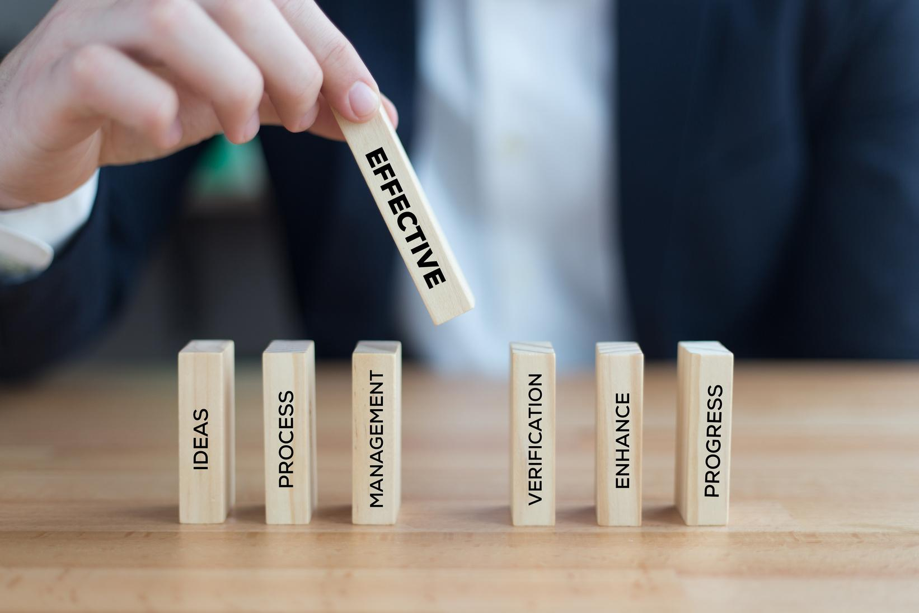
Why is it important?
Promoting awareness
Behaviour change
Advocate for Green initiatives
Improving collaboration

Slide 8
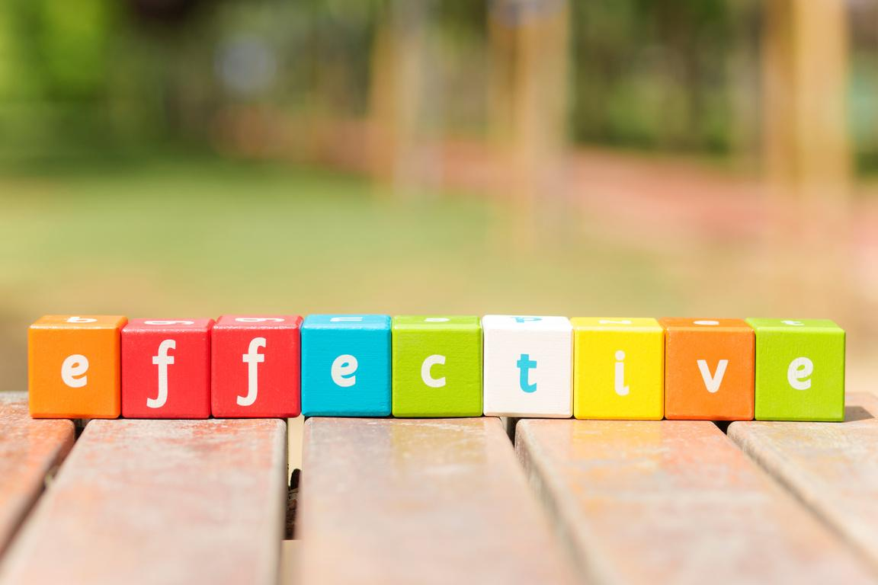
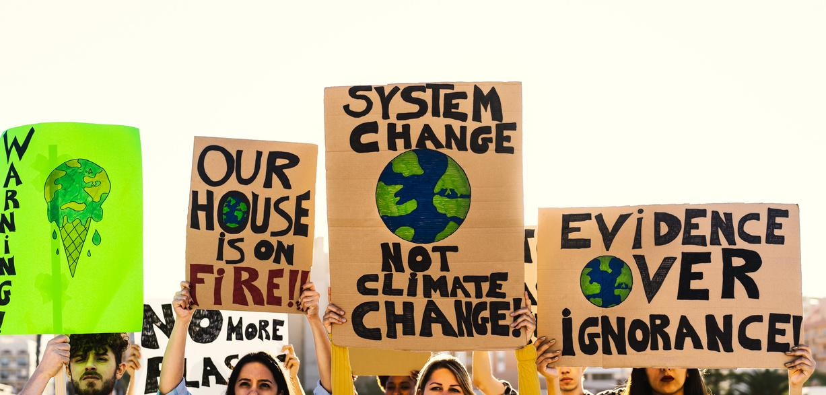
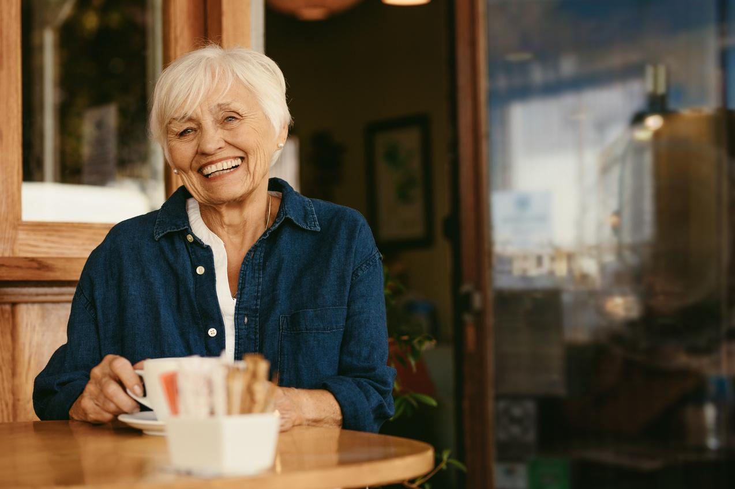
How to improve effective communication for Green practices
  Clarity and simplicity
  Engagement
  Credibility
  Interactivity
  Understand your target audience
  Consistency

Slide 9
ACTIVITY
TIME
EcoTalk Showdown

Slide 10
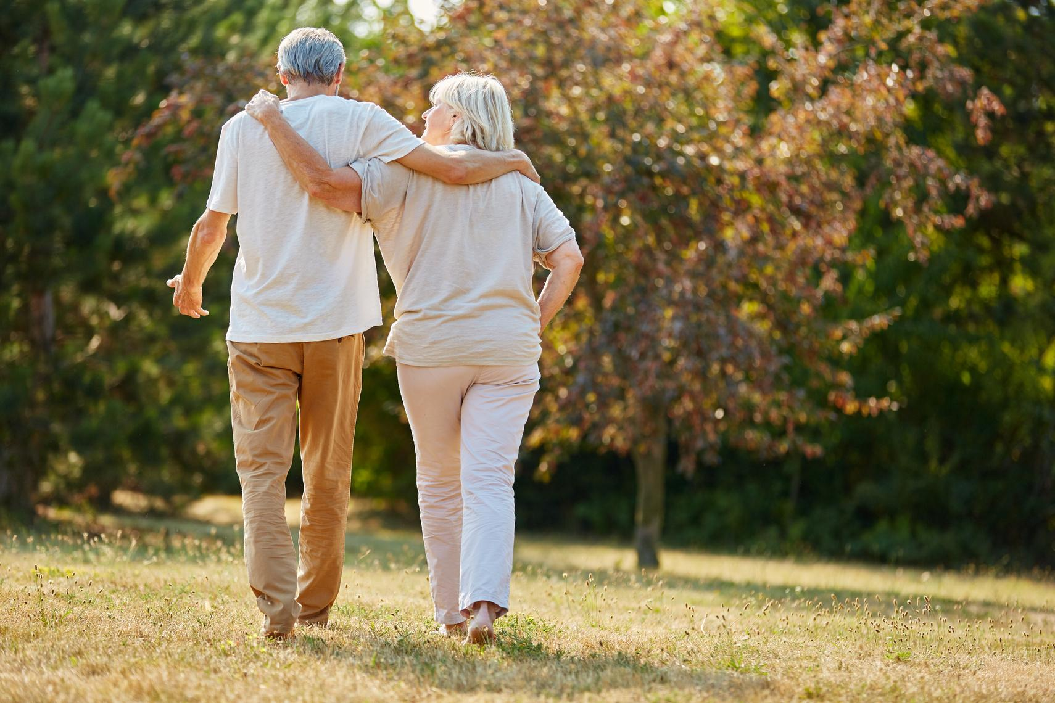
Reflection
  Give an example where you effectively communicated a green message to someone. What made you successful?
  Think of a particular environmental issue that you are concerned about. How would you communicate this issue to someone who may not be familiar with it?

Slide 11

Elements of Green Advocacy

Slide 12
Raising awareness
Education
Elements
Advocacy campaigns
Collaboration
Political engagement
Transparent communication
Behaviour change

Slide 13
ACTIVITY
TIME
Green advocacy collective action plan

Slide 14
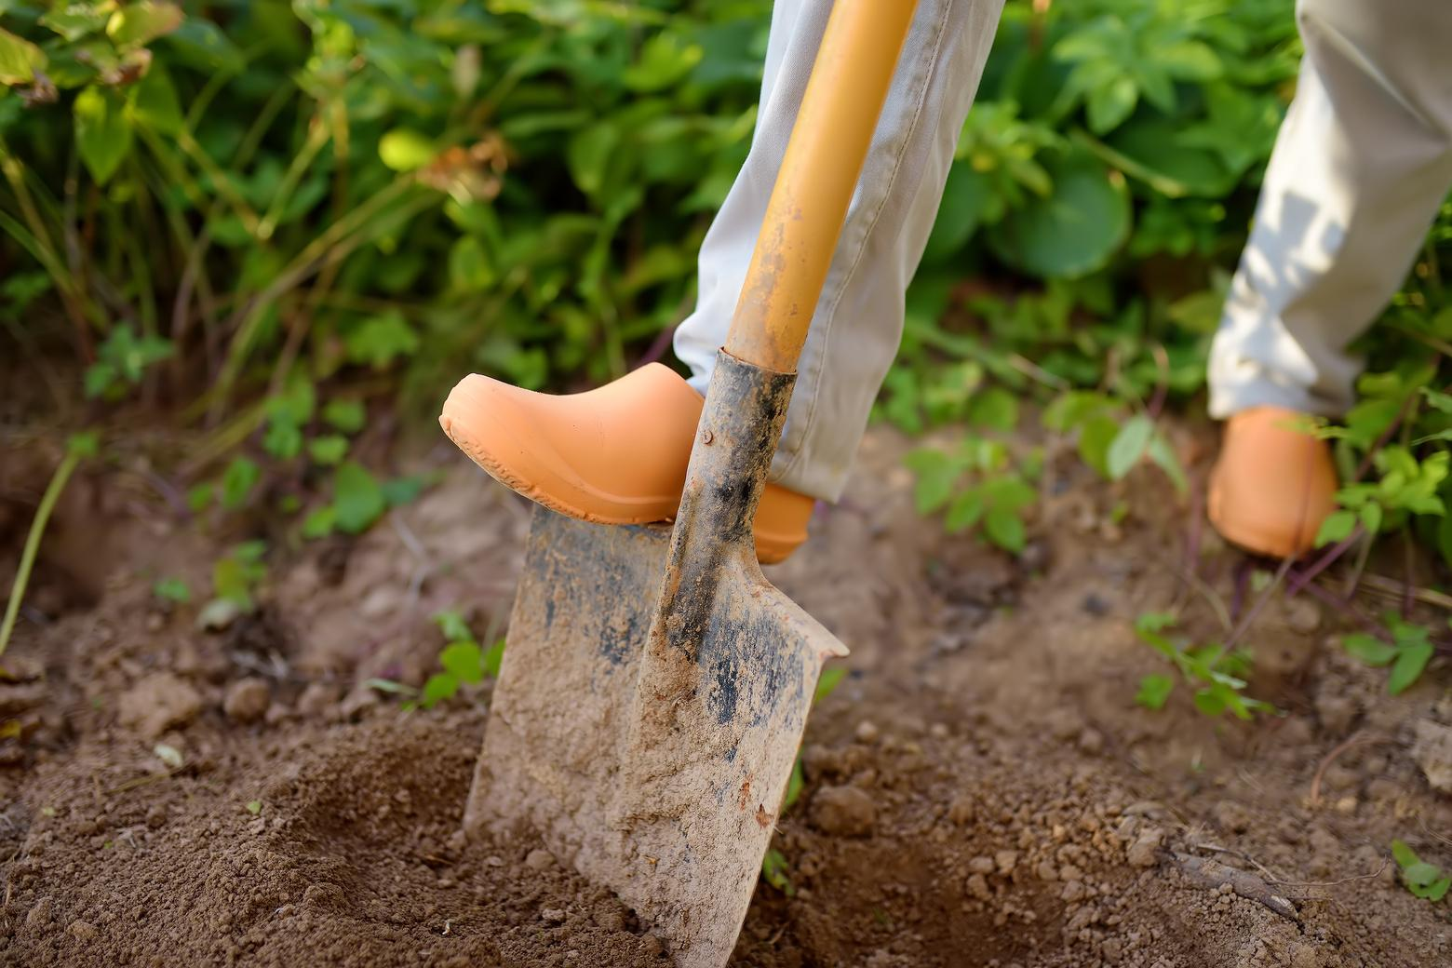
Reflection
  In which everyday situations could you make more environmentally friendly decisions if you had a better understanding of their impact?
  Can you think of specific examples of campaigns you could take part in to make a difference to your environment?

